Slide 1
When Activists Storm the Farm
How to Keep Your Business Safe

Slide 2
Today’s Presenters
Ashley Ellixson, VP of Legal and Environmental Affairs
United Dairymen of Arizona
Chelsea McGuire, Director of Government Relations
Arizona Farm Bureau Federation

Slide 3
DISCLAIMER
This presentation is intended to provide general information and should not be construed as providing legal advice. It should not be cited or relied upon as legal authority. State laws vary and any attempt made to discuss laws of states other than Arizona is for general information to help the viewer better understand Arizona law. For advice about how these issues might apply to your individual situation, consult an attorney.

Slide 4
The Animal Rights Protest: Activists and Where to Find Them

Slide 5
The “Vigil”
Normally peaceful
Activists remain on public property or outside the boundaries of the operation
No interaction with animals
Photo: Phoenix Animal Save Facebook Page

Slide 6
The “Protest”
Still peaceful, but more confrontational
Activists may attempt to enter private property
Some interaction with (or attempts to interact with) animals
Photo: Ruth Iorio, The Guardian

Slide 7
The “Rescue Operation”
The goal is intervention in the operation’s activities
Activists physically enter the operation to remove animals therefrom
Often require law enforcement intervention
Photo: Beth Schlaner, Press Democrat

Slide 8
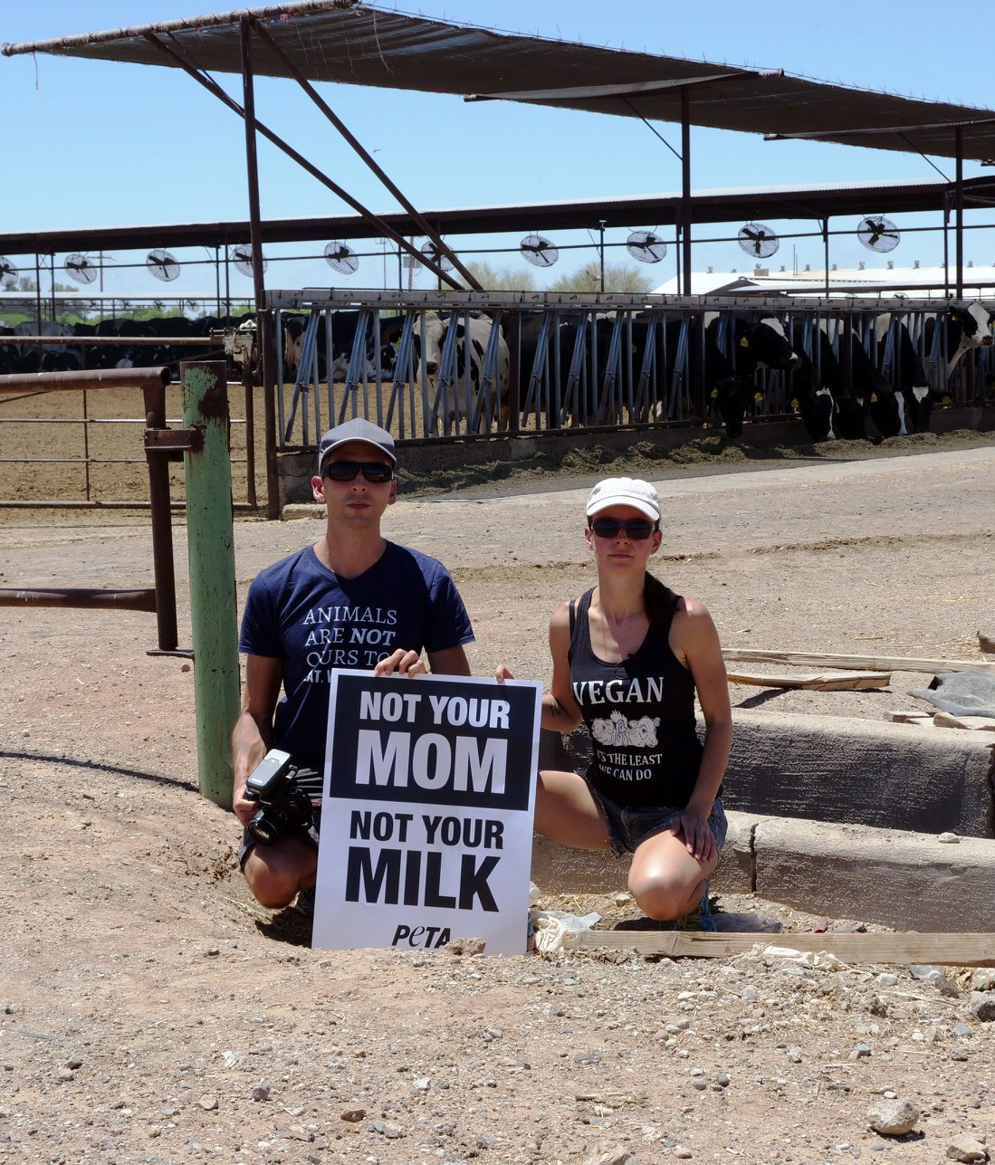
Other Strategies
Organized “days” or events publicized nation-wide
NARD: National Animal Rights Day
Tying in other hot-button issues to boost involvement:
Women’s Rights
Reproductive Rights
Worker Protection & Safety
Claims of “legal authority” to justify illegal action
Op-eds and law review articles are not legal authority!
Court orders, law enforcement commands, and statutes are legal authority
Photo: Phoenix Animal Save Facebook Page

Slide 9
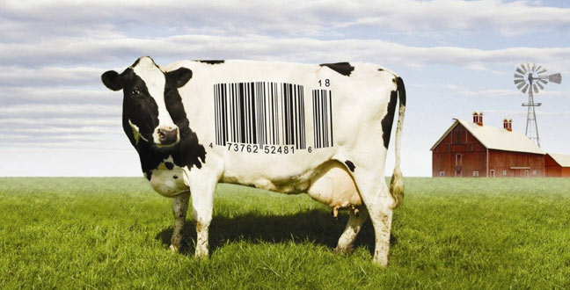
What to Watch For
Breaking news:
Viral interviews
Coverage of a catastrophic event or a bad actor
Educational materials:
New study or scientific claim
Documentaries
Books

Slide 10
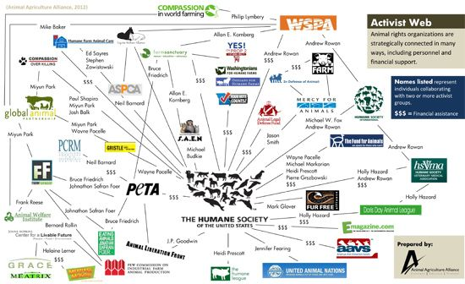
Developing Your Radar
Follow key activist groups on social media, email lists, etc.
National groups:
HSUS
Direct Action Everywhere
Local groups:
Phoenix Animal Save
The Earthlings Experience Arizona

Slide 11
Developing Your Radar
Follow key allies even more closely!
Animal Agriculture Alliance: www.animalagalliance.org
Humane Watch: www.humanewatch.org
Arizona Farm Bureau: www.azfb.org
American Farm Bureau: www.fb.org
National Ag Law Center: www.nationalaglawcenter.org

Slide 12
How to Prepare
Establish policies and procedures for dealing with activists and communicate them to your employees
Do you engage in conversation?
When do you contact law enforcement?
Become familiar with what Arizona’s trespass and animal welfare statutes really say
Know your rights as a landowner and business owner!

Slide 13
Protocol for Activist Relations & Trespass Laws in AZ

Slide 14
Overview
What is and is NOT trespassing?
Arizona Law
Drone Issues
What can the landowner do when activists trespass?
Not trespassing?
Photo from Phoenix Animal Liberation Society

Slide 15
What is trespassing?
Criminal Trespass
Varies from state to state
Arizona:
FIRST DEGREE (ARS 13-1504)
A person commits first degree criminal trespassing when an individual:
1.Enters or remains on a residential structure unlawfully.
2.Enters or remains in a fenced residential yard.
3.Enters a residential yard and looks into the residential structure, violating the owner’s right to privacy.
4.Enters or remains on real property that has mineral claim and intends to hold, work, or take minerals from the claim or lease.
5.Enters or remains on a person’s property and burns, defaces, or manipulates a religious symbol without the owner’s permission.
6.Enters or remains on a public services facility unlawfully.

Slide 16
What is trespassing?
Criminal Trespass
FIRST DEGREE CONTINUED….
A person who violates paragraphs 1, 5, or 6 of the criminal code A.R.S. 13-1504 is guilty of a class 6 felony. A person who violates paragraphs 2, 3, or 4 of the criminal code is guilty of a class 1 misdemeanor.
Misdemeanor Penalties
Imprisonment: No more than 6 months in jail.
Fine: Not to exceed $2,500.
Felony Penalties
Imprisonment: No more than 18 months in jail.
Fine: Not to exceed $150,000.

Slide 17
What is trespassing?
SECOND DEGREE (13-1503)
An individual commits criminal trespassing in the second degree when they:
1.Enter or remain on a nonresidential property or in any commercial fenced yard unlawfully.
Someone who commits trespassing in the second degree is guilty of a class 2 misdemeanor.
Imprisonment: No more than 4 months in jail.
Fine: Not to exceed $750.

Slide 18
What is trespassing?
THIRD DEGREE (13-1502)
A person commits criminal trespassing in the third degree when a person:
1.Enters or remains unlawfully on any real property after the owner or any other person with lawful control over the property has asked you to leave.
2.Enters or remains unlawfully on the right-of-way for tracks, storage, switching yards, or rolling stock of a railroad company.
Criminal trespassing in the third degree is a class 3 misdemeanor.
Imprisonment: No more than 30 days in jail.
Fine: Not to exceed $500.

Slide 19
What is NOT trespassing?
Activists standing on the dirt next to your property
Activists standing on a sidewalk near you property
Even if your farm is the subject of the protest, if the activists are not placing items on your property or physically on your property, they are NOT trespassing

Slide 20
Landowner’s Rights
What can you do if an activist is trespassing?
DO report to local law enforcement immediately.
DO learn who they are and what their concerns are in a respectful manner.
DO NOT be combative. Remember, they may be videotaping you.
DO NOT have a large group approach these individuals, as this may escalate the situation and bring more attention to their cause.

Slide 21
Landowner’s Rights
DO notify them that they are on private property and ask them to leave.
DO NOT use force.
DO write down their vehicle’s license plate number.
DO film the activists and their drones – you are legally allowed to do so. Be aware that they will always have cameras/recorders present – even hidden.

Slide 22
Landowner’s Rights
DO let local law enforcement handle the situation if activists refuse to leave.
DO contact your state/regional trade association to alert them of the situation.

Slide 23
But Ashley, what about drones?!

Slide 24
Landowner’s Rights
Activists have used drones to take photographs of animal welfare issues as well as environmental violations
Or what they claim the pictures/videos to illustrate
The FAA regulations do not address legal issues regarding privacy and the use of a UAS/drone
https://agrilife.org/texasaglaw/2016/09/19/drone-rules/
Notes:
Hudson Case (Maryland)-lawsuit filed in 2010 by Waterkeep Alliance-”manure pile” viewed by plan which could have easily been viewed by drone today-claimed violation of the CWA- was not manure, was animal carcasses, Hudson family won but legal fees caused tremendous economic pain/hardship
We have been made aware that an animal rights activist organization has hired a private drone operator to take footage of dairies in California. It is likely that their goal is to obtain evidence of extreme heat stress, animal deaths and improper carcass disposal.

Slide 25
Landowner’s Rights

Slide 26
Why No?
Original view of property law
You own from the heaven to the center of the Earth.
View changed with adoption of airplanes
Air above your land became public domain
Today regulated by both state (below navigable airspace) and feds (above navigable airspace).
Plus usually have cameras on them that will capture who shot it down (ie really good evidence in court of you destroying someone’s property)
Notes:
Kentucky man recently shot down a drone flying over his property:
Arrested and charged with criminal mischief and wanton endangerment.
Charges have been dismissed
Similar issue in California

Slide 27
Why No?
So this means, NO trespass violation for drones.
The airspace above your property is technically not yours
However, could have other legal claims:
Nuisance
an unlawful interference with your use and enjoyment of an owner’s property
Drone case: repeated flying over livestock found to be a nuisance
Notes:
DO report to local law enforcement immediately.
• DO NOT use force or touch/shoot the drones. The FAA classifies Unmanned Aircraft Systems (UAS) – or drones – as aircraft. In some jurisdictions, willfully shooting at an aircraft is punishable by up to 20 years in jail. The FAA has jurisdiction above ground, and local authorities can only take action if the drone is peeking into your house.
• DO take photographs and videotape the drone, if possible. • DO try to get any serial numbers you can find on the drone (if you can get close enough), because the FAA requires owners of drones between .55 lbs. and 55 lbs. to register their crafts.

Slide 28
Landowner’s Rights
What can you do if an activist is NOT trespassing?
DO set up a barrier to notify everyone where private property begins to avoid trespassing
courtesy of Jason Van Der Toorn

Slide 29
Landowner’s Rights
DO notify local law enforcement to put them on notice in case issues arise.
DO NOT engage with aggressive activists.
DO contact your state/regional trade association to alert them of the situation.
DO NOT touch or shoot drones, even if they are flying over your property – that’s ILLEGAL.

Slide 30
Landowner’s Rights
TAKE AWAY:
If activists are being civil, not trespassing or interfering with operations, they can legally protest.
courtesy of Jason Van Der Toorn

Slide 31
From Our Own Livestock Officers
Trespass
Call 911
Dispatch Number for Livestock officers (8)
623-445-0281
Priority Rank
City/County variations
No Trespassing Signs
Be a TRUE victim
Prosecute to the fullest extent allowed by law
Get to know your local law enforcement
Notes:
No absolute that authorities will act a certain way

Slide 32
RESOURCES

Slide 33
Legal Extension Specialist: Tiffany Dowell Lashmet
tdowell@tamu.edu
Blog: http://agrilife.org/texasaglaw
Podcast: aglaw.libsyn.com
Twitter: @TiffDowell

Slide 34
Legal Extension Specialist: Paul Goeringer, University of Maryland
Blog
Podcast
New episodes 2x per month covering risk management education issues
www.marylandagpodcast.org
Find also on iTunes, Google Play, and TuneIn
Updated periodically with timely legal, crop insurance, farm policy, and water conservation information.
www.agrisk.umd.edu
Signup for updates on the site to get new posts emailed to you, or Text 999066 to 1-781-262-3877 to signup

Slide 35
Thank you!
A recording of the webinar, as well as our slides and supplemental information, will be available after the webinar.
For questions or resources, contact us at:
Chelsea McGuire, chelseamcguire@azfb.org
Ashley Ellixson, aellixson@UDAZ.org
Notes:
Check your email for more details; or, if you have questions for us, please don’t hesitate to reach out. Our emails are listed there and we are happy to help.

